Slide 1
TTM4175 Introduction to Communication Technology and Digital Security (2023)
Muhammad Mudassar Yamin
24/08/2023

Slide 2
About me
Associate Professor at NTNU
PhD from NTNU between 2018-2022 in ‘Modeling and analyzing attack defense scenrios in Cyber Ranges’
PostDoc from NTNU 2022-2023 while focusing on AI-Driven cyber secuirty scenario modeling
Around 10 years of experience in various organzaition for custing and research

Slide 3
Agenda
Introduction to Cybersecurity: What it is and why it's important.
Why Cybersecurity Matters: Understanding the risks.
Common Cyber Threats: Types of cyberattacks you should be aware of.
Basic Cybersecurity Tips: Practical steps to stay safe online.
Q&A: Your chance to ask questions and clarify doubts.

Slide 4

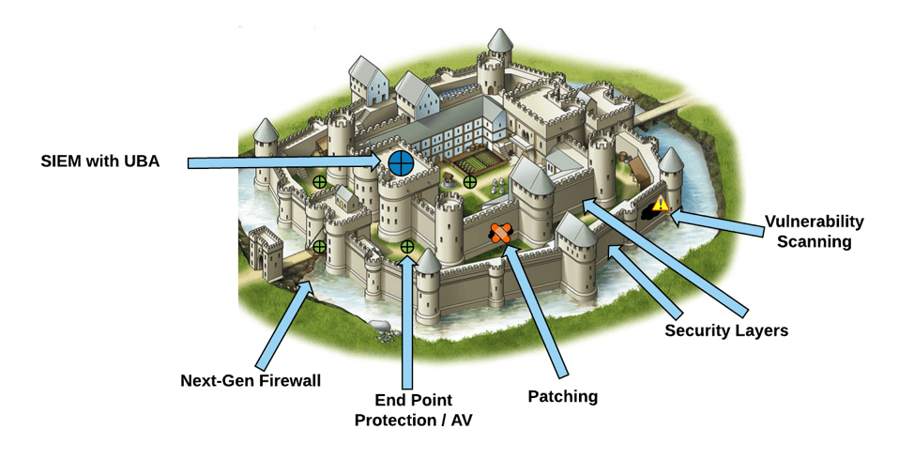

Vulnerabilities in Systems
Defense in depth
Legitimate user requirements
Hacker

Slide 5
What is Cybersecurity?
Definition: Cybersecurity refers to the practice of safeguarding computer systems, networks, and data from theft, damage, or unauthorized access.
Importance: Cybersecurity is crucial because it protects our personal information, financial assets, and privacy in the digital world.

Slide 6
Why Cybersecurity Matters
Cyberattacks are on the rise: The number and sophistication of cyberattacks continue to increase.
Personal and financial information is at risk: Hackers target individuals and organizations to steal sensitive data or money.
Protecting against cyber threats is everyone's responsibility: We all play a role in maintaining a secure online environment.

Slide 7
Common Cyber Threats
Malware: Malicious software designed to harm your computer or steal your data.
Phishing attacks: Deceptive attempts to trick individuals into revealing sensitive information.
Password breaches: Unauthorized access to systems by cracking or stealing passwords.
Social engineering: Manipulating people into divulging confidential information through various techniques.

Slide 8
Malware
Definition: Malware, short for malicious software, includes viruses, Trojans, and worms that can damage your computer or steal your data.
Examples: Viruses infect your files, Trojans disguise as legitimate software, and worms self-replicate to spread.

Slide 9
Phishing Attacks
Definition: Phishing is a type of cyberattack where attackers use deceitful emails, websites, or messages to trick individuals into revealing sensitive information such as passwords or credit card numbers.
Example: A fake email claiming to be from your bank, asking you to click a link and enter your login credentials.

Slide 10
Password Breaches
Definition: Password breaches occur when hackers gain unauthorized access to a system by either cracking weak passwords or stealing them from databases.
Importance of strong, unique passwords: Using strong, unique passwords for different accounts helps prevent unauthorized access.

Slide 11
Social Engineering
Definition: Social engineering is the manipulation of individuals into divulging confidential information or performing actions that compromise security.
Example: An attacker posing as a trusted colleague who requests sensitive information or access to systems.

Slide 12
Basic Cybersecurity Tips
Use strong, unique passwords: Combine letters, numbers, and symbols and avoid easily guessable passwords.
Enable two-factor authentication (2FA): Adds an extra layer of security by requiring a second verification method alongside a password.
Keep software and devices up to date: Regular updates patch security vulnerabilities.
Be cautious with email and links: Verify sender authenticity and avoid clicking on suspicious links.
Regularly back up important data: Protect against data loss due to cyberattacks by maintaining backups.

Slide 13
Group Discussion
Did you use strong, unique passwords for different web and mobile applications? If not, why?
Did you enabled two-factor authentication (2FA) for various applications you use? If not, why?
Did you keep software and devices you use up to date? If not, why?
Did you verify sender authenticity on emails and avoid clicking on suspicious links? If not, why?
Did you regularly back up important data? If not why?

Slide 14
Password Tips
Use a mix of uppercase and lowercase letters, numbers, and symbols.
Avoid using easily guessable passwords like "password123."
Consider using a reputable password manager to generate and store strong passwords securely.

Slide 15
Two-Factor Authentication (2FA)
Definition: 2FA requires two forms of verification (e.g., a password and a code from your smartphone) to access an account.
Adds an extra layer of security, even if your password is compromised.

Slide 16
Keeping Software Updated
Regular updates are essential because they patch security vulnerabilities.
Enable automatic updates when possible to ensure you're protected against known threats.

Slide 17
Being Cautious with Email
Don't click on suspicious links or download attachments from unknown sources.
Verify the sender's email address, especially if you receive unexpected or unusual emails.

Slide 18
Backing Up Data
Regular backups protect against data loss in case of cyberattacks or hardware failures.
Use cloud storage, external drives, or dedicated backup software to automate the process.

Slide 19
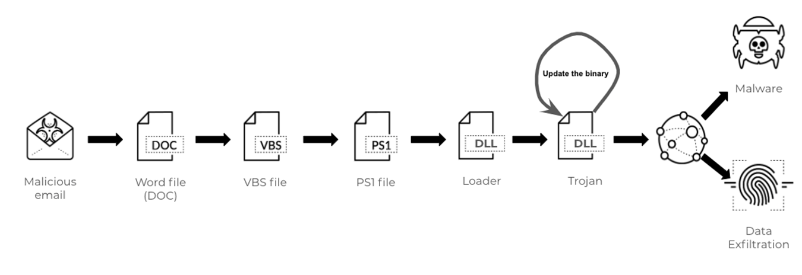
Real-Life Examples
https://unit42.paloaltonetworks.com/attack-chain-overview-emotet-in-december-2020-and-january-2021/

Slide 20
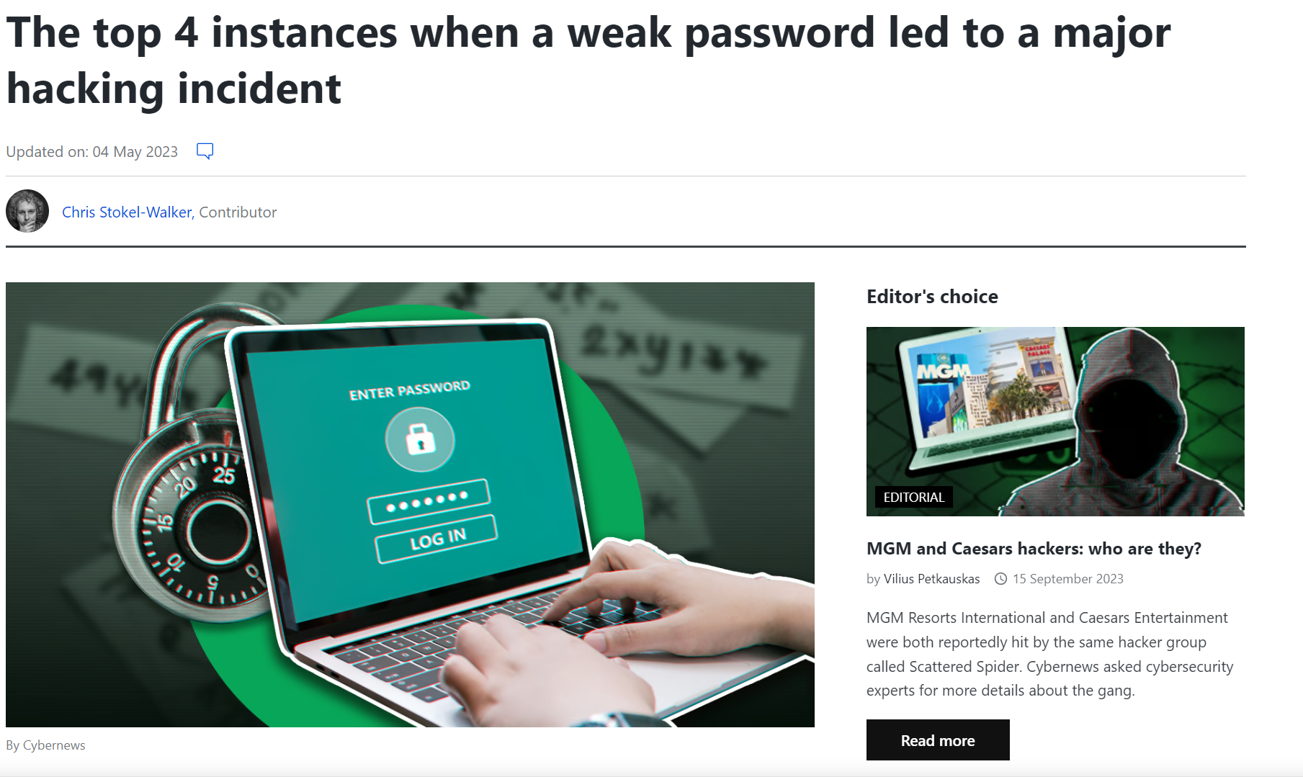
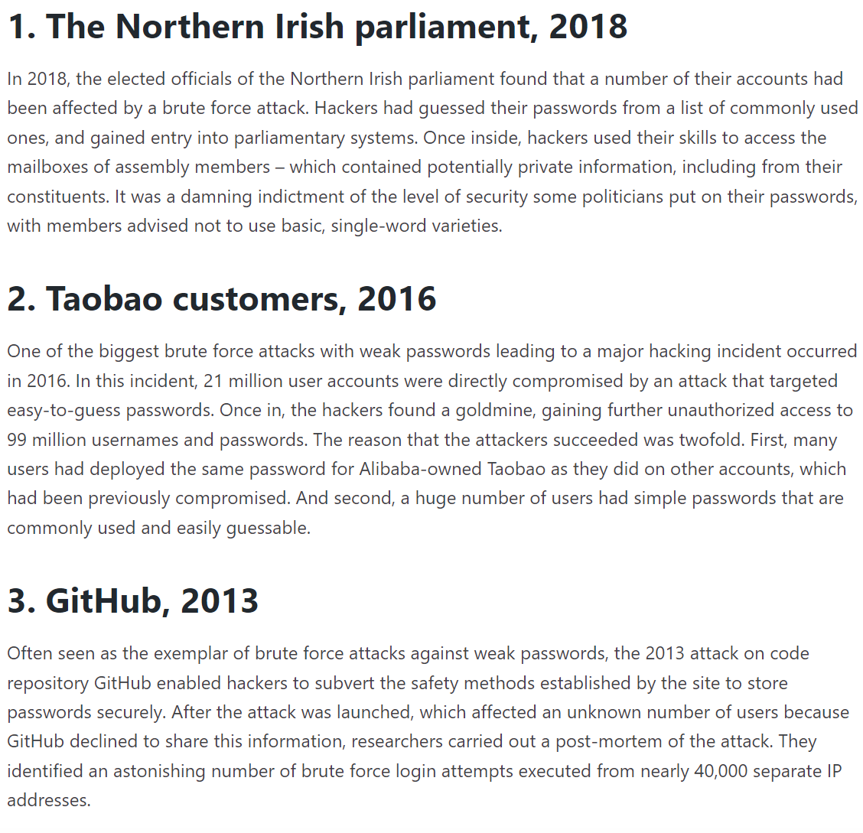
Real-Life Examples
https://cybernews.com/security/cost-of-week-password-hacking/

Slide 21
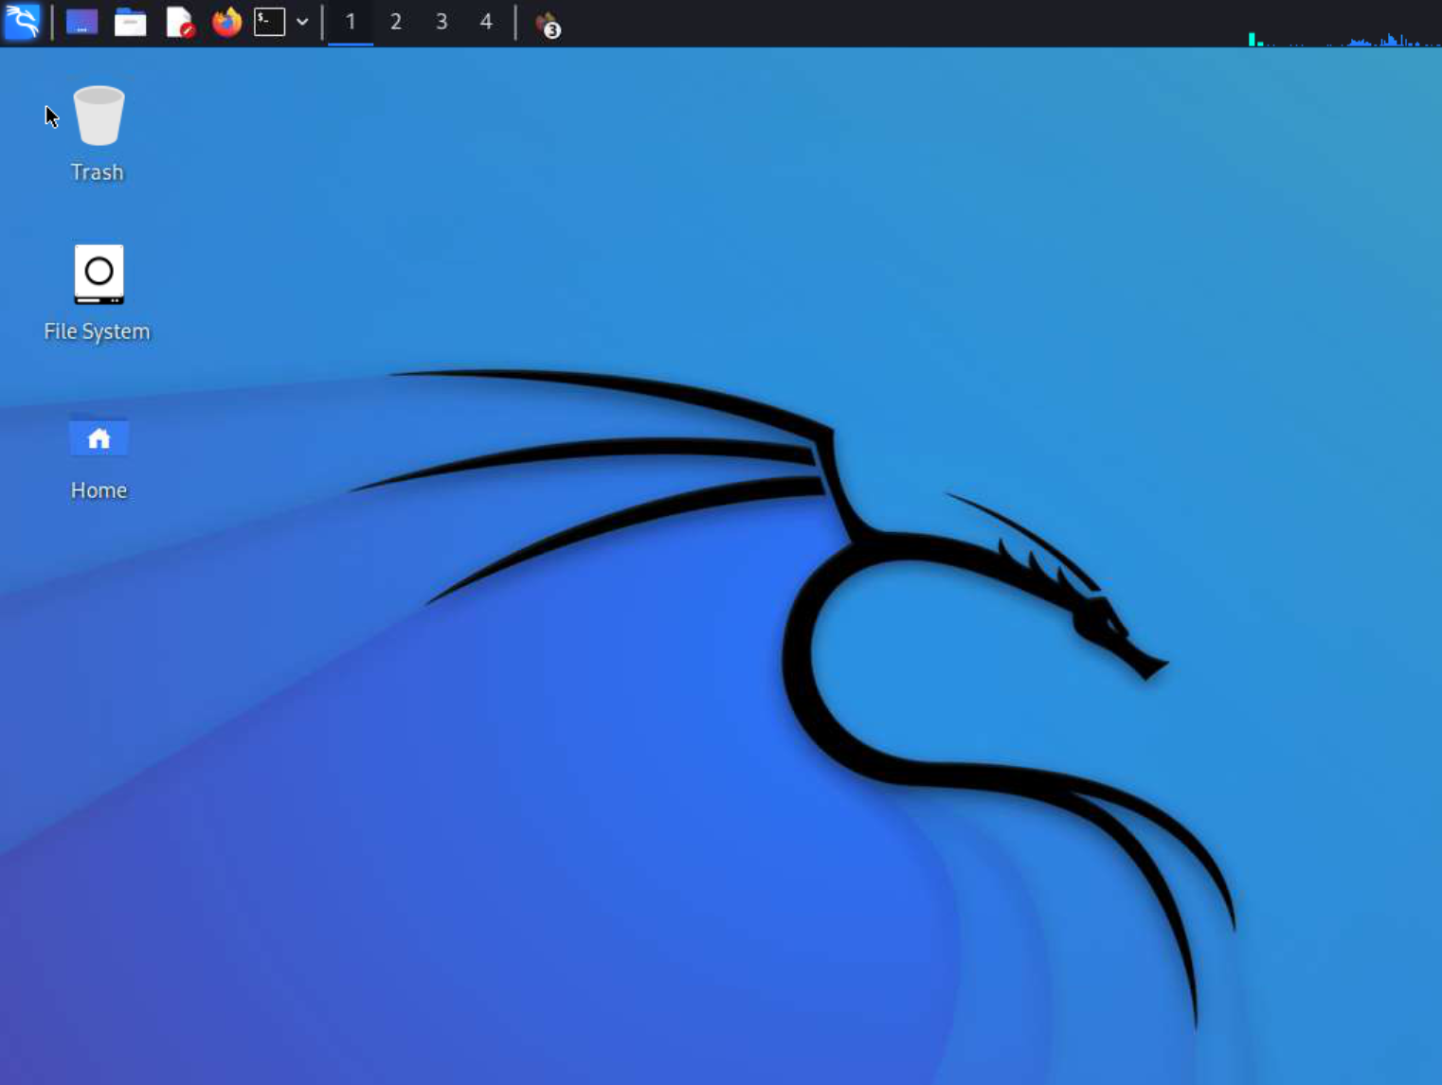
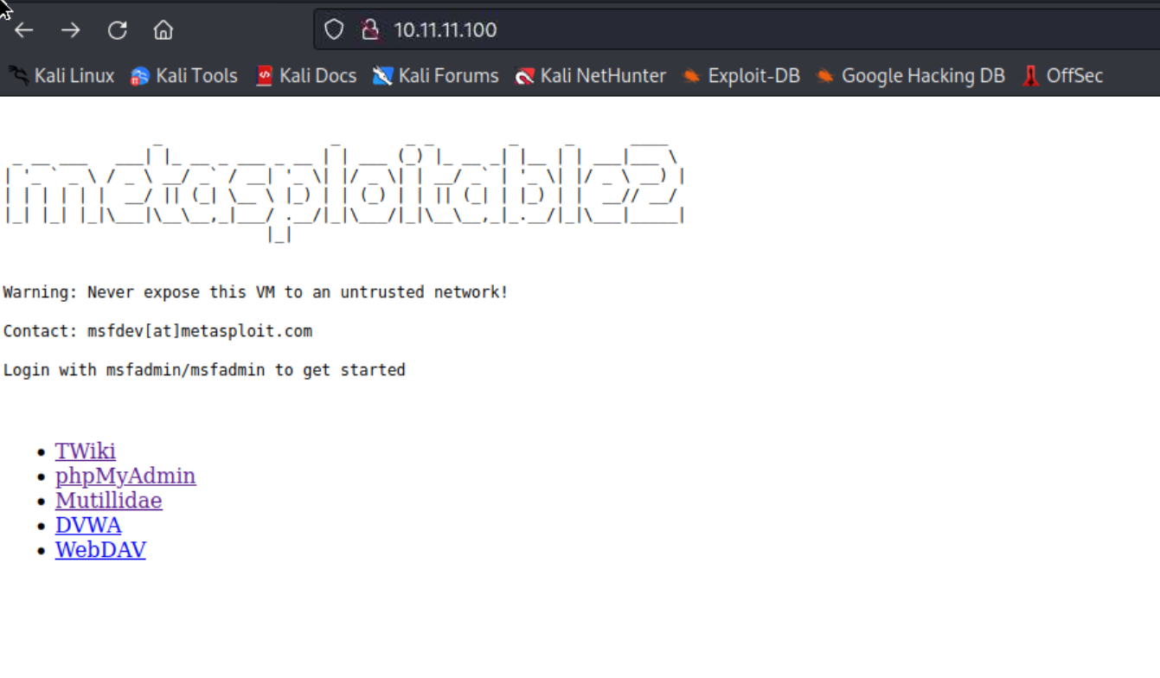
Local Lab Interfaces
Attacker:10.11.11.11
Test:10.11.11.100

Slide 22
Task 1
Go to https://www.abuseipdb.com/
Find a malicious IP address
Scan it with Virus total https://www.virustotal.com/gui/home/url

Slide 23
Task 2
Go to https://virusshare.com/hashes
Find hashes of malicious files
Scan the hashes on https://www.virustotal.com/gui/home/search

Slide 24
Task 3
Go to https://haveibeenpwned.com/
Check your email addresses, are they compromised or not?

Slide 25
Questions?
Muhammad.m.yamin@ntnu.no

